Slide 1
OUTPUT
An output device is any piece of computer hardware equipment which converts information into human-readable form . It can be text graphics audio and video . A out put is perform work just the opposites the input dives some of the output devices are visual display units I.e a monitor printer graphic output device . A new type of output device is been developed these day , known as speech synthesize a mechanism attached to the computer which provides verbal output sounding almost like human speech.

Slide 2
Any information that is processed by and sent out from a computer or other electronic device is considered output an example of output is anything viewed on your computer. Monitor screen such as the words you type on your keyboard output devices is any device used to send data from a computer to another device or user most computer data output that is meant for humans are in this categories. Some examples include monitors, projector , speaker, headphones and printers

Slide 3
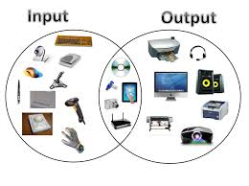
EXAMPLES OF OUTPUT
Combination of input and output device

Slide 4
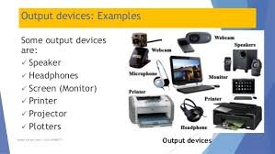
CONT……

Slide 5
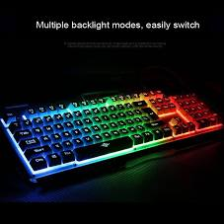
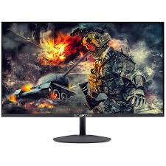
OUTPUT DEVICE
INPUT DEVICE

